Slide 1

November 22
Update
The attack of pcolormesh

Slide 2


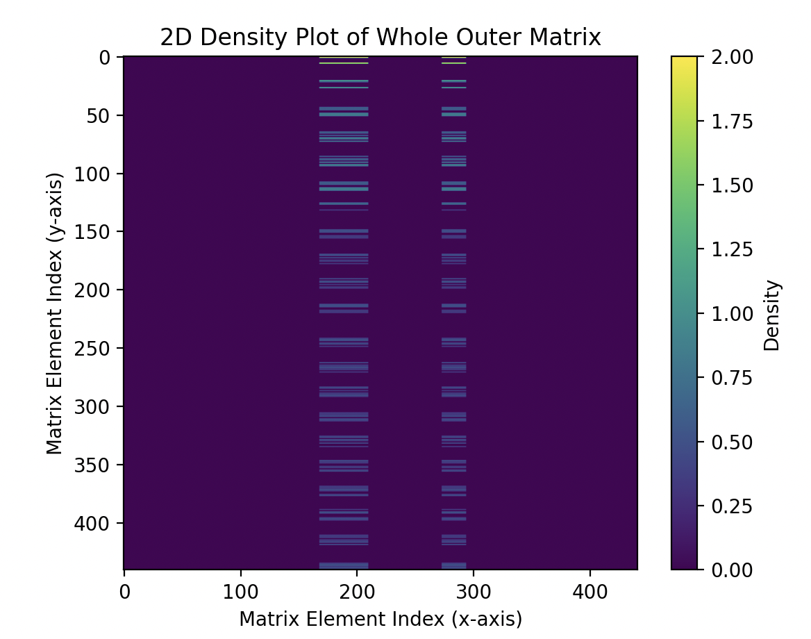
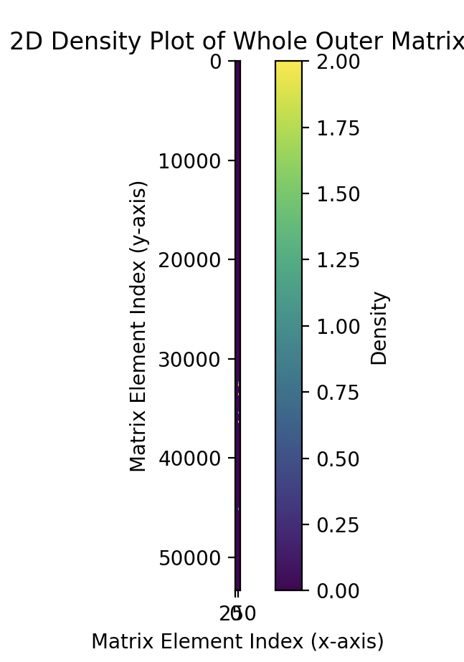
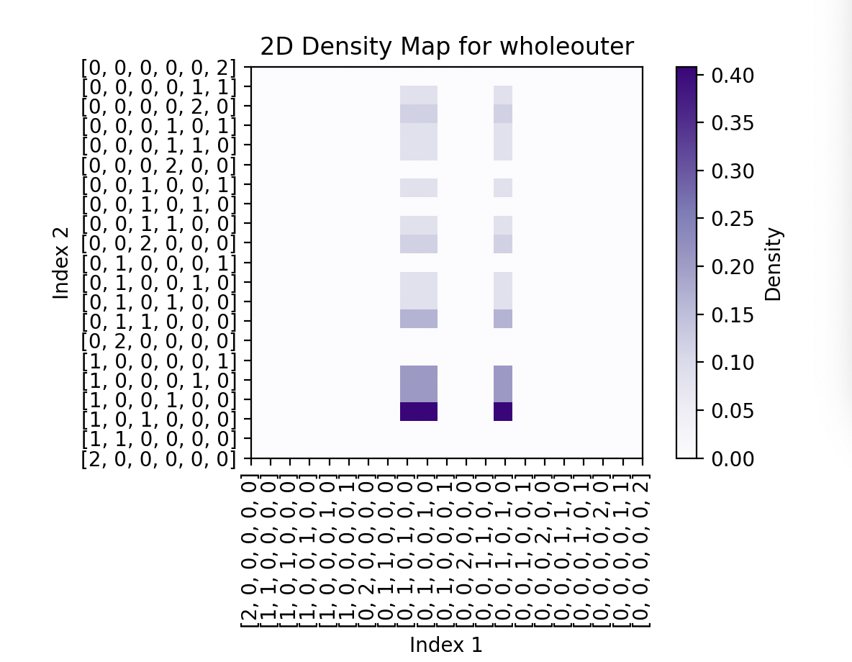
Code
Click on the "Google Slides" button below this presentation preview.
Click on "Make a copy."
Start editing your presentation.
You need to sign in to your Google account.
- I don’t think this is right
- better than the 53336 x 620 matrix I was getting….
- should normalize psi?
- also maybe the reason its not working is bc im taking the absolute
- notable failed graphs
GOOGLE SLIDES

Slide 3
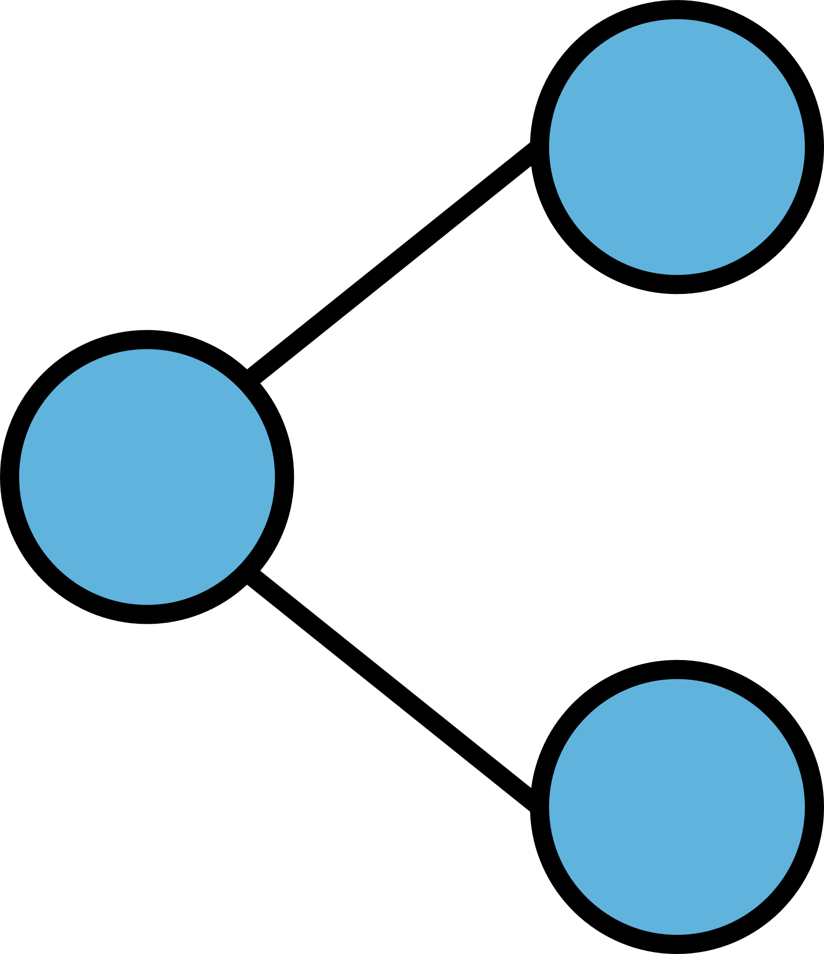
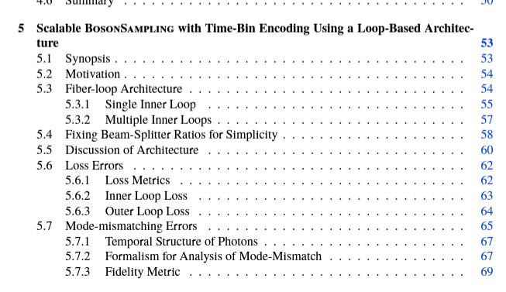
Articles
- Looked more into Motes
- I know so much lore now
- None of it is actually helpful though
- He also has a mushroom growing license
- HOWEVER I found this good paper he wrote
- mix of the 2 other papers but it seems
to have good references (looking through them)
GOOGLE SLIDES

Slide 4
EOM
- ok what *is* an EOM?
- its not the MZI (?) since it can be hooked up to an MZI?
-but to me it seems like …. It does about the same-ish thing?
GOOGLE SLIDES

Slide 5
Misc
- Have my report due on the 26th (27th actually but I don’t like handing stuff in ‘late’)
- working on the draft
- got any tips?
- What kind of EOMs should I pay attention to? Free space or fiber-coupled ?
- how should I study for EM?

